Slide 1
One hour
For sleep
For English learning
For English listening and speaking
For code review
…

Slide 2
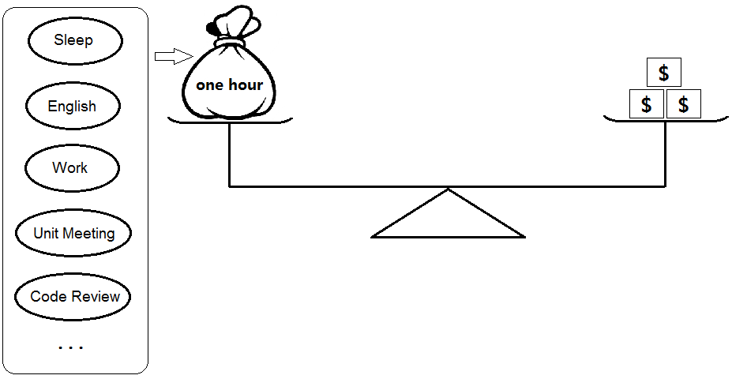
One hour—value

Slide 3
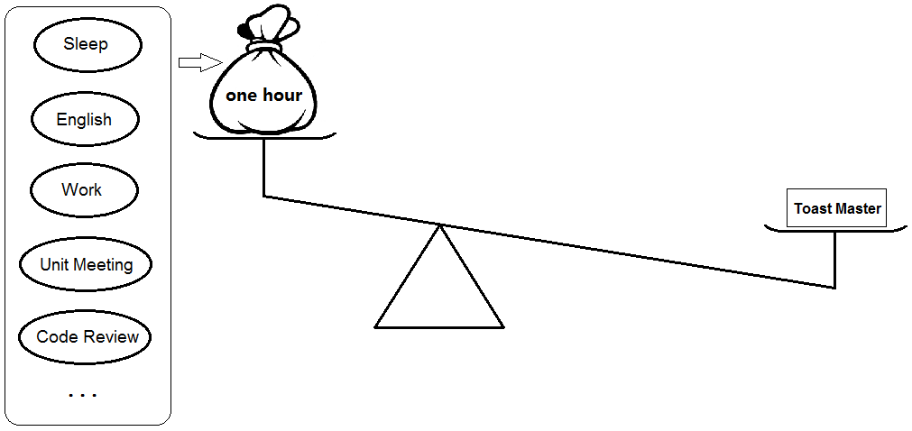
One hour -- all lose to toast master

